Slide 1
Tabari Harvey
Module 9.2 Assignment
CSD380

Slide 2
Selecting the Right DevOps Metrics
Wide range of DevOps metrics available
Not all metrics apply to every organization
Hard to identify which metrics are most valuable

Slide 3
Selecting Metrics
Adopt a data-driven approach
Use analytics dashboards to visualize patterns
Focus on bottlenecks and improvement areas

Slide 4
Security in DevOps
Traditional security slows down rapid releases
Continuous delivery = frequent deployments
Security often added too late in the cycle

Slide 5
Decision Paralysis
Too many tool choices (AWS, GCP, Azure; Terraform, Ansible, Pulumi)
Inefficiency, duplicate tools, higher costs
Slowdowns, complexity

Slide 6
Roadblocks to Access
Developers struggle with tool access
Inconvenient interfaces
Incorrect permissions
Missing documentation

Slide 7
Poor Visibility
DevOps spans many systems which becomes hard to track
With no monitoring, it is hard to diagnose issues
Difficult to improve
Blind spots

Slide 8
Governance and Compliance
Freedom to innovate compared to security controls
Bad governance: Security gaps
Regulatory penalties
Slows delivery

Slide 9
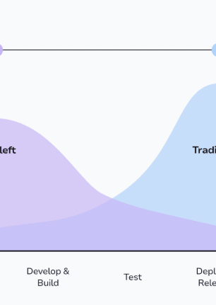
Solution
“One of the key principles here is “shifting left,” which brings security tasks into the earlier phases of your process instead of leaving them for the end. Doing so not only helps identify potential vulnerabilities sooner but also ensures that protection is continuous throughout the entire software delivery lifecycle” (Walker, Sep 2025)

Slide 10
Works Cited
https://sematext.com/blog/devops-challenges/
https://spacelift.io/blog/devops-challenges

